Slide 1
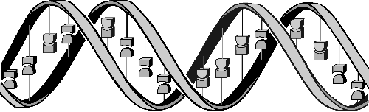
Genetic Algorithm
Nobal Niraula
University of Memphis
Nov 11, 2010

Slide 2
Outline
Introduction to Genetic Algorithm (GA)
GA Components
Representation
Recombination
Mutation
Parent Selection
Survivor selection
Example

Slide 3
Slide sources
Most of the contents are taken from :
Genetic Algorithms: A Tutorial By Dr. Nysret Musliu, Associate Professor Database and Artificial Intelligence Group, Vienna University of Technology.
Introduction to Genetic Algorithms, Assaf Zaritsky Ben-Gurion University, Israel (www.cs.bgu.ac.il/~assafza)

Slide 4
Introduction to GA (1)
Search Techniqes
Guided random search techniqes
Enumerative Techniqes
Calculus Base Techniques
Fibonacci
Sort
DFS
Dynamic Programming
BFS
Tabu Search
Hill Climbing
Simulated Anealing
Evolutionary Algorithms
Genetic Programming
Genetic Algorithms

Slide 5
Introduction to GA (2)
“Genetic Algorithms are good at taking large, potentially huge search spaces and navigating them, looking for optimal combinations of things, solutions you might not otherwise find in a lifetime.”- Salvatore Mangano, Computer Design, May 1995.
Originally developed by John Holland (1975)
The genetic algorithm (GA) is a search heuristic that mimics the process of natural evolution
Uses concepts of “Natural Selection” and “Genetic Inheritance” (Darwin 1859)

Slide 6
Use of GA
Widely-used in business, science and engineering
Optimization and Search Problems
Scheduling and Timetabling

Slide 7
Let’s Learn Biology (1) ☺
Our body is made up of trillions of cells. Each cell has a core structure (nucleus) that contains your chromosomes.
Each chromosome is made up of tightly coiled strands of deoxyribonucleic acid (DNA). Genes are segments of DNA that determine specific traits, such as eye or hair color. You have more than 20,000 genes.
A gene mutation is an alteration in your DNA. It can be inherited or acquired during your lifetime, as cells age or are exposed to certain chemicals. Some changes in your genes result in genetic disorders.

Slide 8
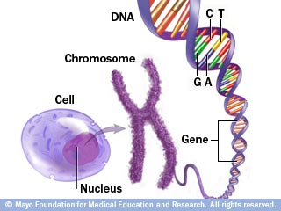
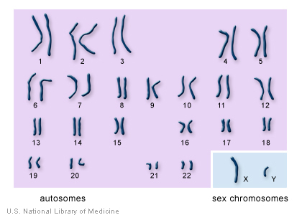
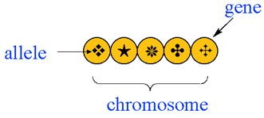
Let’s Learn Biology (2) ☺
Source: http://www.riversideonline.com/health_reference/Tools/DS00549.cfm
1101101

Slide 9
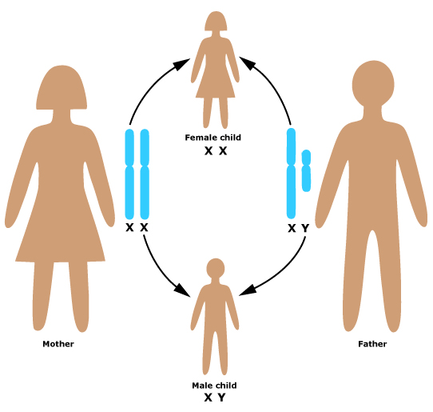
Let’s Learn Biology (3) ☺

Slide 10
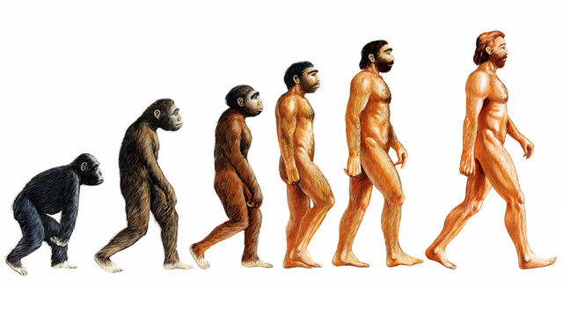
Let’s Learn Biology (4) ☺
Natural Selection
Darwin's theory of evolution: only the organisms best adapted to their environment tend to survive and transmit their genetic characteristics in increasing numbers to succeeding generations while those less adapted tend to be eliminated.
Source: http://www.bbc.co.uk/programmes/p0022nyy

Slide 11
GA is inspired from Nature
A genetic algorithm maintains a population of candidate solutions for the problem at hand, and makes it evolve by iteratively applying a set of stochastic operators

Slide 12
Nature VS GA
The computer model introduces simplifications (relative to the real biological mechanisms),
BUT
surprisingly complex and interesting structures have emerged out of evolutionary algorithms

Slide 13
High-level Algorithm
produce an initial population of individuals
evaluate the fitness of all individuals
while termination condition not met do
select fitter individuals for reproduction
recombine between individuals
mutate individuals
evaluate the fitness of the modified individuals
generate a new population
End while

Slide 14
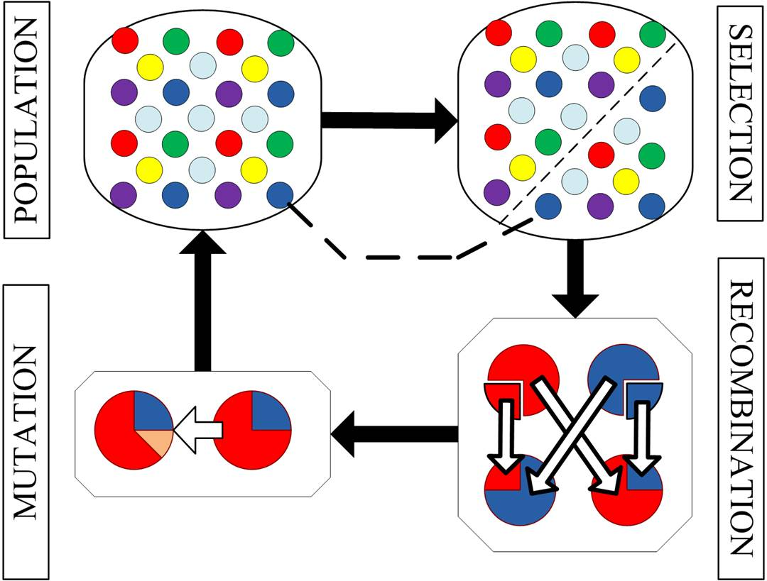
GA Components
Source: http://www.engineering.lancs.ac.uk

Slide 15
GA Components With Example
The MAXONE problem : Suppose we want to maximize the number of ones in a string of L binary digits
It may seem trivial because we know the answer in advance
However, we can think of it as maximizing the number of correct answers, each encoded by 1, to L yes/no difficult questions`

Slide 16
GA Components: Representation
Encoding
An individual is encoded (naturally) as a string of l binary digits
Let’s say L = 10. Then, 1 = 0000000001 (10 bits)

Slide 17
Algorithm
produce an initial population of individuals
evaluate the fitness of all individuals
while termination condition not met do
select fitter individuals for reproduction
recombine between individuals
mutate individuals
evaluate the fitness of the modified individuals
generate a new population
End while

Slide 18
Initial Population
We start with a population of n random strings. Suppose that l = 10 and n = 6
We toss a fair coin 60 times and get the following initial population:
s₁ = 1111010101
s₂ = 0111000101
s₃ = 1110110101
s₄ = 0100010011
s₅ = 1110111101
s₆ = 0100110000

Slide 19
Algorithm
produce an initial population of individuals
evaluate the fitness of all individuals
while termination condition not met do
select fitter individuals for reproduction
recombine between individuals
mutate individuals
evaluate the fitness of the modified individuals
generate a new population
End while

Slide 20
Fitness Function: f()
We toss a fair coin 60 times and get the following initial population:
s₁ = 1111010101 f (s₁) = 7
s₂ = 0111000101 f (s₂) = 5
s₃ = 1110110101 f (s₃) = 7
s₄ = 0100010011 f (s₄) = 4
s₅ = 1110111101 f (s₅) = 8
s₆ = 0100110000 f (s₆) = 3
---------------------------------------------------
= 34

Slide 21
Algorithm
produce an initial population of individuals
evaluate the fitness of all individuals
while termination condition not met do
select fitter individuals for reproduction
recombine between individuals
mutate individuals
evaluate the fitness of the modified individuals
generate a new population
End while

Slide 22
Selection (1)
Next we apply fitness proportionate selection with the roulette wheel method:
We repeat the extraction as many times as the number of individuals
we need to have the same parent population size (6 in our case)
1
2
Area is Proportional to fitness value
Individual i will have a probability to be chosen
n
3
4

Slide 23
Selection (2)
Suppose that, after performing selection, we get the following population:
s1` = 1111010101 (s1)
s2` = 1110110101 (s3)
s3` = 1110111101 (s5)
s4` = 0111000101 (s2)
s5` = 0100010011 (s4)
s6` = 1110111101 (s5)

Slide 24
Algorithm
produce an initial population of individuals
evaluate the fitness of all individuals
while termination condition not met do
select fitter individuals for reproduction
recombine between individuals
mutate individuals
evaluate the fitness of the modified individuals
generate a new population
End while

Slide 25
Recombination (1)
aka Crossover
For each couple we decide according to crossover probability (for instance 0.6) whether to actually perform crossover or not
Suppose that we decide to actually perform crossover only for couples (s₁`, s₂`) and (s₅`, s₆`).
For each couple, we randomly extract a crossover point, for instance 2 for the first and 5 for the second

Slide 26
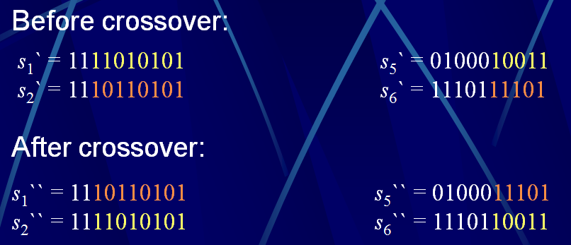
Recombination (2)

Slide 27
Algorithm
produce an initial population of individuals
evaluate the fitness of all individuals
while termination condition not met do
select fitter individuals for reproduction
recombine between individuals
mutate individuals
evaluate the fitness of the modified individuals
generate a new population
End while

Slide 28
Mutation (1)
Before applying mutation:
s₁`` = 1110110101
s₂`` = 1111010101
s₃`` = 1110111101
s₄`` = 0111000101
s₅`` = 0100011101
s₆`` = 1110110011
After applying mutation:
s₁``` = 1110100101
s₂``` = 1111110100
s₃``` = 1110101111
s₄``` = 0111000101
s₅``` = 0100011101
s₆``` = 1110110001

Slide 29
Mutation (2)
The final step is to apply random mutation: for each bit that we are to copy to the new population we allow a small probability of error (for instance 0.1)
Causes movement in the search space (local or global)
Restores lost information to the population

Slide 30
High-level Algorithm
produce an initial population of individuals
evaluate the fitness of all individuals
while termination condition not met do
select fitter individuals for reproduction
recombine between individuals
mutate individuals
evaluate the fitness of the modified individuals
generate a new population
End while

Slide 31
Fitness of New Population
After Applying Mutation:
s₁``` = 1110100101 f (s1```) = 6
s₂``` = 1111110100 f (s2```) = 7
s₃``` = 1110101111 f (s3```) = 8
s₄``` = 0111000101 f (s4```) = 5
s₅``` = 0100011101 f (s5```) = 5
s₆``` = 1110110001 f (s6```) = 6
-------------------------------------------------------------
37

Slide 32
Example (End)
In one generation, the total population fitness changed from 34 to 37, thus improved by ~9%
At this point, we go through the same process all over again, until a stopping criterion is met

Slide 33
Distribution of Individuals
Distribution of Individuals in Generation 0
Distribution of Individuals in Generation N

Slide 34
Issues
Choosing basic implementation issues:
representation
population size, mutation rate, ...
selection, deletion policies
crossover, mutation operators
Termination Criteria
Performance, scalability
Solution is only as good as the evaluation function (often hardest part)

Slide 35
When to Use a GA
Alternate solutions are too slow or overly complicated
Need an exploratory tool to examine new approaches
Problem is similar to one that has already been successfully solved by using a GA
Want to hybridize with an existing solution
Benefits of the GA technology meet key problem requirements

Slide 36
Conclusion
Inspired from Nature
Has many areas of Applications
GA is powerful

Slide 37
References
Genetic Algorithms: A Tutorial By Dr. Nysret Musliu , Associate Professor Database and Artificial Intelligence Group, Vienna University of Technology.
Introduction to Genetic Algorithms, Assaf Zaritsky Ben-Gurion University, Israel (www.cs.bgu.ac.il/~assafza)

Slide 38
Thank You !

